Slide 1
“It is a profoundly erroneous truism that we should cultivate the habit of thinking of what we are doing. The precise opposite is the case. Civilization advances by extending the number of important operations which we can perform without thinking about them.”
Alfred North Whitehead

Slide 2

Introducing Front-end MACHINE LEARNING
Using Tensorflow.Js, ml5.js, and OPENAI
Our team. Your advantage.

Slide 3

Who Am I
Name: Jean Louw
Occupation: Senior Principal Consultant
Origins: Electronics Design Engineering
Passion: Easing Human-Computer Integration
(this includes developers and designers)
Notes:
Who am I? Well, as we will see later, this is a bit of an existential question. However, I will just mention here that I am Jean Louw, my occupation is as a Senior Principal Consultant at IQ, my height is above average, looks below average and I have worked on an above average amount of machine learning applications that range from gunshot recognition to farming to insurance from the CSIR to Hollard etc and I have spoken at AI Expo Africa and others on this. My passion is easing the friction that exists between humans and their computing tools because of bad design or technical constraints that only make sense to the developer.

Slide 4
This Masterclass
Intro to Tensorflow
Intro to Tensorflow.JS
Intro to Machine Learning
Intro to Neural Networks
Intro to Tensors
OpenGL / WebGL / Node Tensors
Create TensorFlow Hello World
Explore TFJS prediction app
Create ML5.js app
Create Open AI app
BONUS: LOTTERY PREDICTIONS!
Notes:
To that effect, I believe AI and ML can help make a huge difference by improving the way in which we interact with our devices and environments and the content it serves or by making data more meaningful to humans, offering predictions and matches. This masterclass will attempt to move through quite a lot of content to help you get started with your own machine learning journey. Therefore, if you are quick-fingered, you can attempt to follow along, otherwise you can absorb the info and play with the example code afterwards. With that, let’s jump right in!

Slide 5


Notes:
What is Tensorflow.JS?

Slide 6
What is Tensorflow.js
Open-source Machine Learning Library for JavaScript developed by Google
Not the same as TensorFlow, but part of the same ecosystem with similar API’s
Enables ML capabilities in the browser, as well as through Node.JS implementations
Deeplearn.js - 2018
TFJS V1 - 2019
TFJS V2 - 2020
TFJS V3 - 2021
TensorFlow - 2015

Slide 7

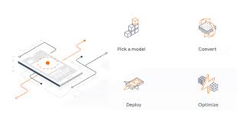

Why Use Front-end Machine Learning
Utilize Device
Utilize Machine Learning
Utilize Javascript
Camera, accelerometer, GPS, etc
Computing Power Delegation
Add ML features to your web app
Import existing Tensorflow models from Python
Great cultural fit for startup projects
Huge and active community
Protect privacy by running in browser / Node. Js server
Notes:
https://federated.withgoogle.com/
https://whatwebcando.today/

Slide 8
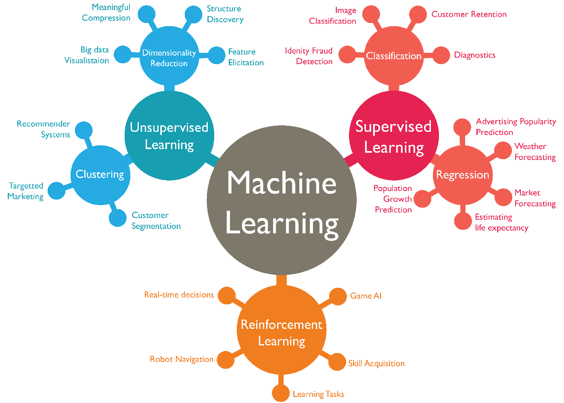
What is Machine Learning
Subcategory of artificial intelligence
Perform tasks without explicitly coded rules
Behaviour is based on data instead of rules
Typical ML tasks are some form of prediction
Improved results with experience
Algorithms often based on biological learning

Slide 9
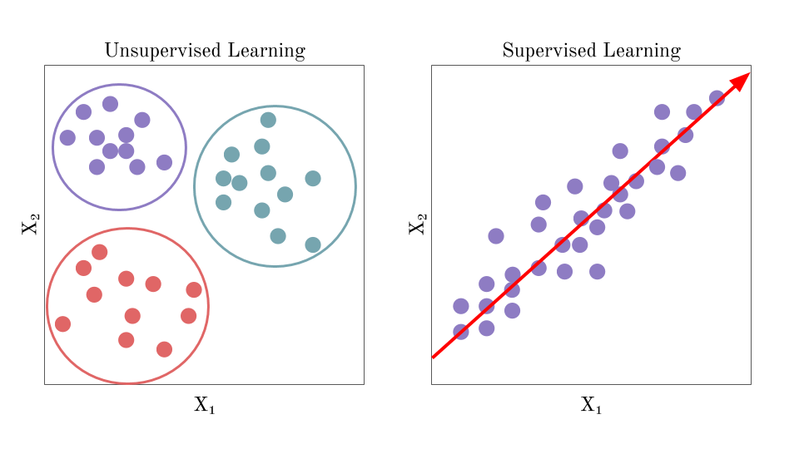
Supervised Learning
Unsupervised learning
Based on data with labels added, and an algorithm trained on that data (eg classification)
We don't have a dataset for training our algorithm, instead we are trying to get patterns in the data we do have (eg clustering)

Slide 10
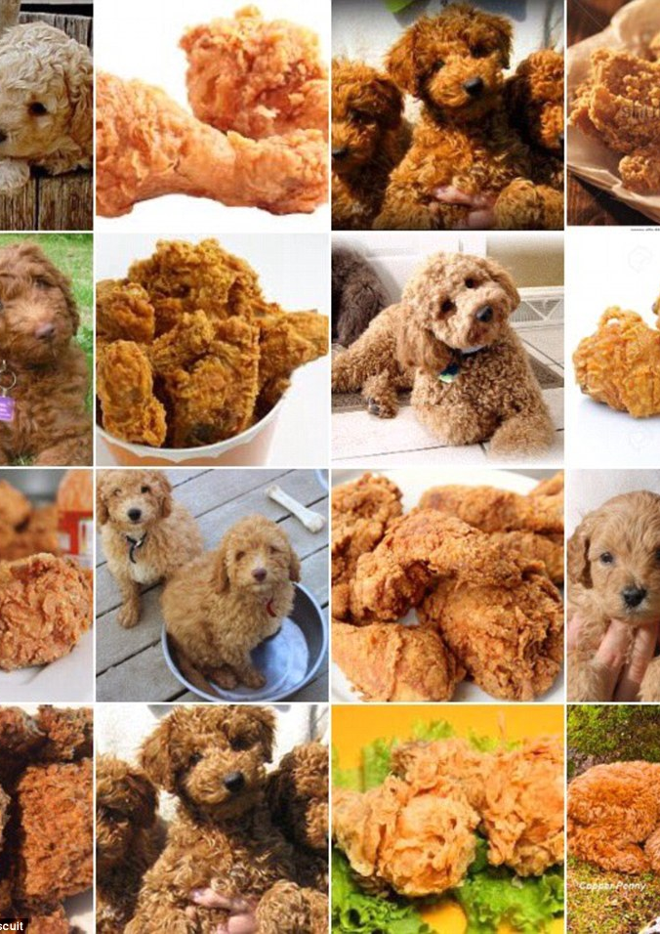
Training and Testing
Creating a model based solely on the dataset can cause errors
Best practice to split dataset into a training set and testing set
Optionally, add a third part: the validation set
After training the model on the training set, assess its performance by applying it to the testing set.
The validation set is sometimes used to calibrate the model during training through multiple epochs

Slide 11
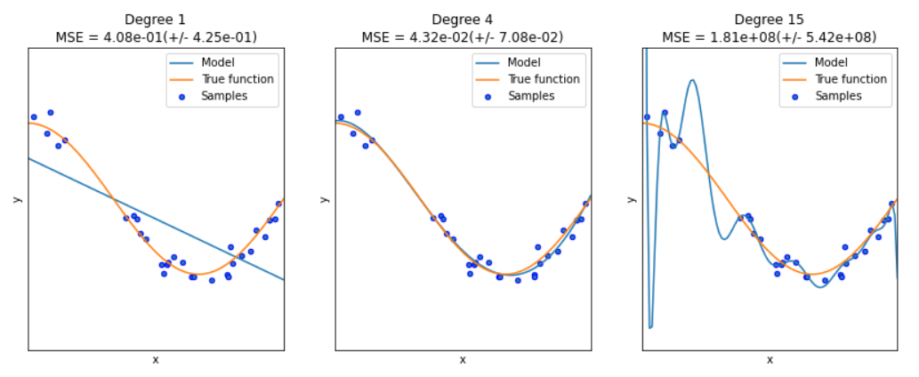

Slide 12
Errors in training
overfitting
Loss Functions:
Model is trained on seen data and not unseen data
If overfit, it would have low accuracy when presented with new data
This is why we use a training set
Measure how well a model fits the data
Distance from line to point
Calculate for all points
Take an average
Aim to minimize with an optimizer
Typical loss function: mean-squared error (MSE)
Notes:
How do we know our model is any good?

Slide 13
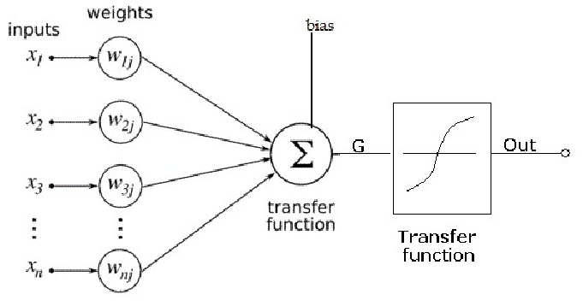
Artificial Neurons
Inspired by biological neurons
Basic building block of ANN is the artificial neuron
There can be any number of inputs
For the first input, we multiply the raw input, x1, by weight, w1
We do the same for all inputs, which are summed, and a bias added
We pass the result through what is know as an activation / transfer function
Traditionally the activation function is based on a threshold (step function)
Modern networks have smoother functions such as Sigmoids

Slide 14
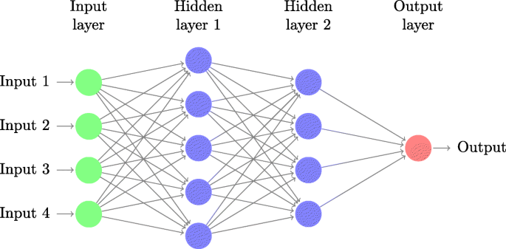
Neural Network Structure
A neuron on its own does not work well, but combining them in a network does
To construct a network, the neurons/nodes are arranged in layers placed in sequence
A neural network can have any number of layers
Common to have an input layer, an output layer and hidden layers between
When using the network for prediction, we only deal with the input and output layers
We feed input into nodes of input layer, feed forward and let the output of the final layer be the output of the network
When training the network, we compare the output values to the expected labels / data
We use the backpropagation algorithm which works backwards through the layers of the network, updating the parameters of the nodes to minimize the error
Parameters being updated are weights and biases

Slide 15
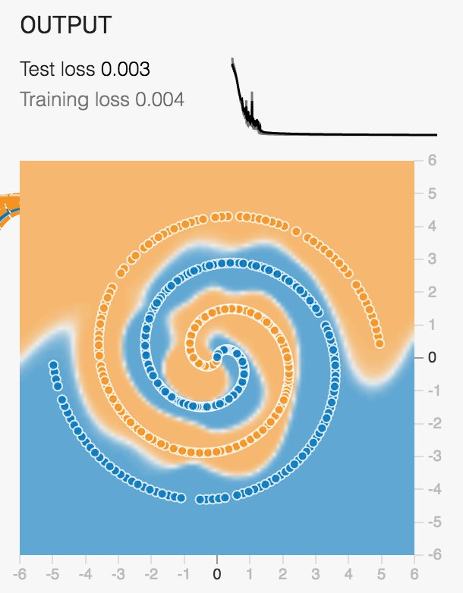
Notes:
Do not adjust your screen. This is not a test. Allows you to play around with neural network
• Change number of layers, nodes, activation function and other params
• You can train the model, see the prediction and visualize the loss
• We can see see step by step
• The training set loss is higher than the testing set
• If we remove layers then we can see that there is not enough complexity, unless we change the data

Slide 16
(again)
Notes:
Now that we’ve covered the boring parts, let’s get back to tensorflow js

Slide 17
My First TensorFlow.Js Application
Install TFJS
Create new HTML
Test Tensorflow
Only prerequisite is VS Code
Three ways to download TFJS
Best – grab the CDN from the website
Good - Use NPM to download @tensorflow/tfjs
Worst – Download and compile it yourself from Github
1) Create a new HTML file and call it what you want (just as long as it ends with .html of course)
2) Populate the meta data (html autocomplete)
3) Grab the core CDN tag:
<script src="https://cdn.jsdelivr.net/npm/@tensorflow/tfjs/dist/tf.min.js"></script>
4) Paste it into the head
1) Test by running in Chrome and using console to log "tf.version"
2) On the tensorflow js website there is a code sample that we're going to grab:
https://github.com/tensorflow/tfjs
3) Run the sample
4) Type "tf.getBackend()" in console
Notes:
DEMO

Slide 18
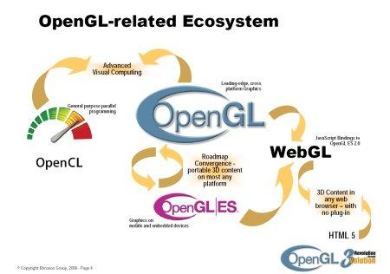
WEBGL in Tensorflow
WebGL is a 3D graphics API for the browser
Based op OpenGL which is a 3D graphics API for native applications
Caniuse.com shows 96% adoption of WebGL in browsers
Tensorflow.js does not use WebGL for visible 3D graphics
Using 3D graphics utilizes the power of the graphics card
CPU's run operations one by one
If we want to add one number to another number, 1+2, that is a single operation
Graphics cards enable us to do matrix operations (grid of numbers that can all be worked on in one operation)
Basically, the GPU is much faster than the CPU for the type of operations that TF needs (100x faster)
TensorFlow uses WebGL because it is consistently available, but does offer a pure JS CPU as a fallback
Notes:
https://get.webgl.org
Caniuse.com We won’t be working with WebGL API’s but only TFJS APIs

Slide 19
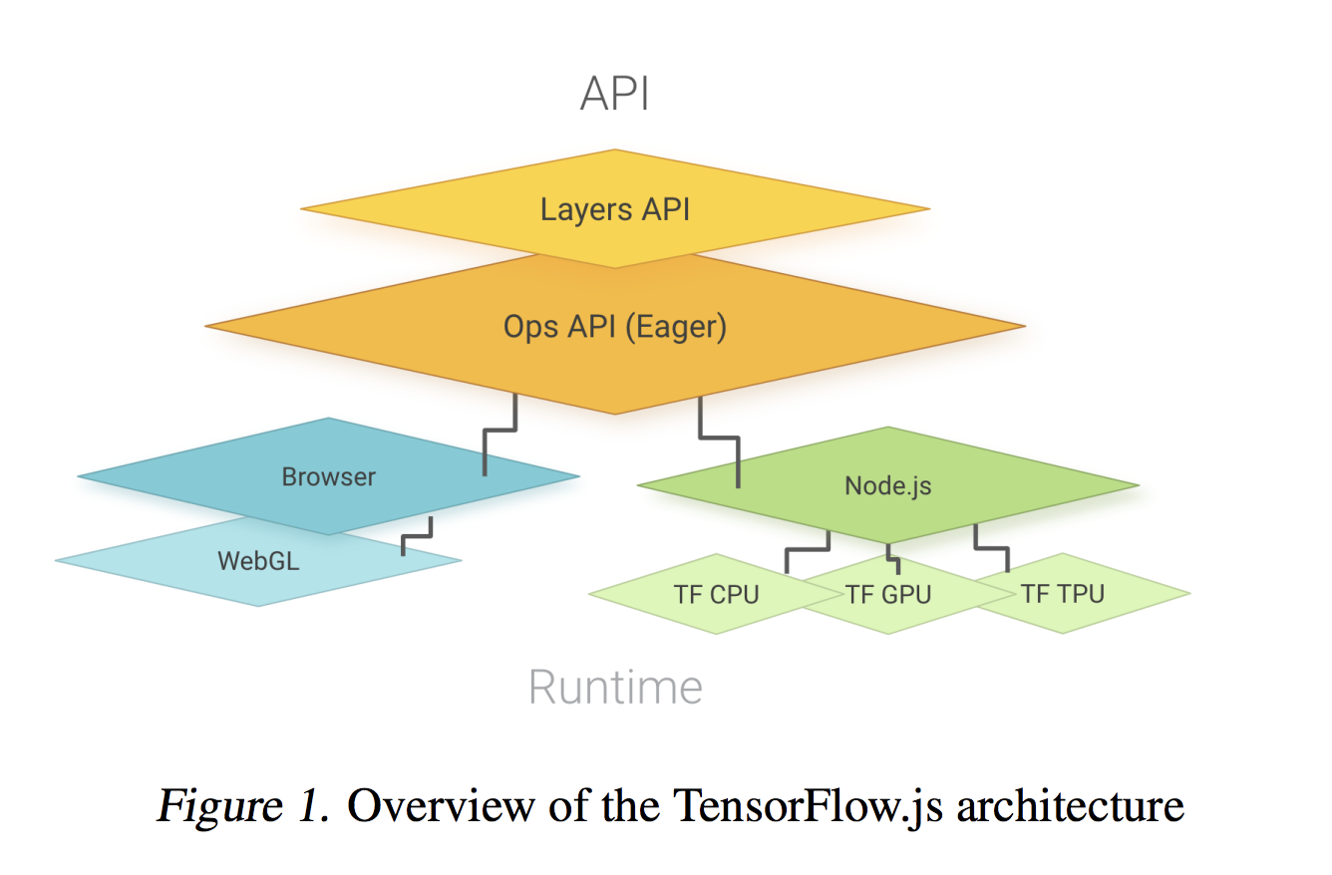
Tensorflow API’s
There are two types of API's available for Tensorflow.js:
Low Level: Operations (ops)
High level: Layers
The API's in Tensorflow.js are designed to be somewhat similar to the original Tensorflow
The operations API in TF.js are similar to the Eager API in Python
The operations API is basically just mathematical operations to manipulate data (add subtract, multiply, etc)
You can use the operations API to build machine learning models, but it is not easy to do so
The Layers API is a higher-level API that allows to define complex models easily
The lower-level API has you define the mathematical structure, but higher level allows you to define layers and nodes
If you've used Tensorflow in Python, the Layers API is very similar to the Keras API
Layers API is typically used to define Artifical Neural Networks but can be used in other ways, too
Notes:
https://js.tensorflow.org/api/latest/

Slide 20
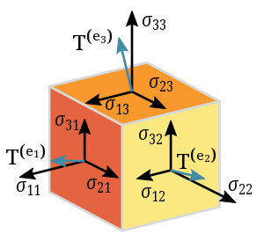
What is a tensor
TFJS treats tensors as data structures and creating one takes three parameters: values, shape, and data type
The first parameter, values, is required. This is unique in data, as that makes the structure somewhat polymorphous
So our definition of a tensor as per the Tensorflow.js API is as follows:
"A tensor is a datastructure that consists of a list of values which have a data type along a number of dimensions that make up its shape."
Handy feature of the docs page is that you can run the code in the browser
Notes:
We can look up the definition of a tensor here:
https://en.wikipedia.org/wiki/Tensor
• It says that a tensor is a geometric object that maps in a multi-linear manner geometric vectors, scalars and other tensors to a resulting tensor
• Unless you're a mathematician, this isn't very clear and the wiki page won't be of much use
• Fortunately, as a developer, you do not need to understand all this and we'll be looking more into the practical side of tensors and their definition
• Let's go back to the API docs and see what TFJS thinks

Slide 21

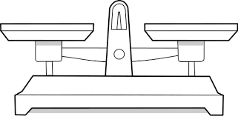
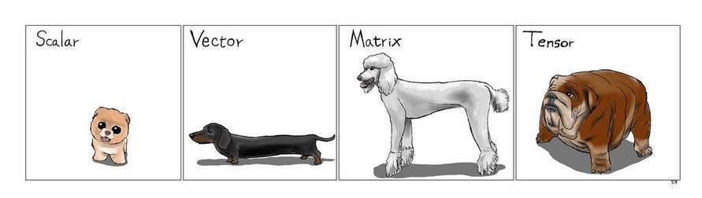
Scalar tensor
The simplest type of tensor is a scalar tensor which holds a single value such as the number 3
A scalar tensor has zero dimensions or has rank zero
We construct the scalar by using one of the following:
tf.scalar(99)
tf.tensor([99],[])
In coding, it's not recommended to use the general function when you can use a more specific function instead
Notes:
I like to look at scalars as a single value like your weight. You weigh 25kg on earth and on the moon.

Slide 22
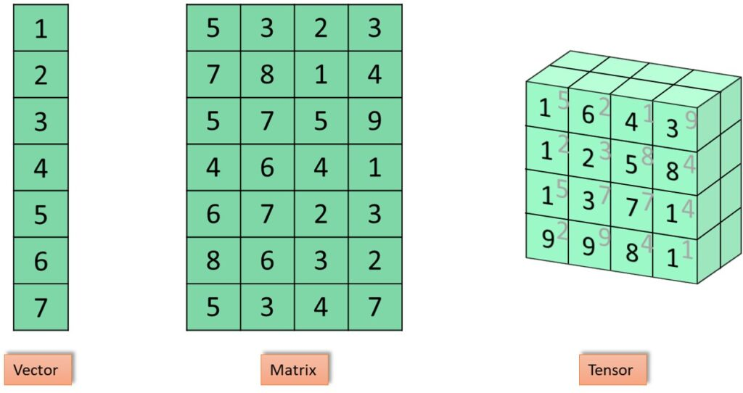
1-Dimensional tensor
A list of values, or an array, or a vector in mathematical terms
When visualizing data in one dimension, you might think of a line with points on that line representing each of the values:
|-----x----x--x-xx-x-x-x-x--x--x-----x--x-----x-----x----|>
This is a valid representation of the data but misses some important info. We also need the position of each value.
This is why a one-dimensional tensor is just like an array. We can visualize the position with explicit labels or visualize it in sequence:
[ 5, 12, 88, 62, 49, 33, 26, 47 ]
Here the index is the position. This extends to more than one dimension as well, as we need to know the position of the value
We construct a one-dimensional tensor by using:
tf.tensor1d([1, 2, 3]) - just pass in an array of values
tf.tensor([1, 2, 3], [3]) - pass in the array of values as the first parameter and the number of dimensions ([x]) and shape (3) as the second
Notes:
I like to look

Slide 23
2-Dimensional tensor
This is an array of arrays
It can be visualized as a two dimensional grid.
We construct a 2D Tensor by using:
tf.tensor2d([[8, 5, 3], [1, 2, 9]]) - just pass in a nested array
tf.tensor([8, 5, 3, 1, 2, 9], [2, 3]) - pass all the values in a single array as first parameter, then the dimensions ([x, y]) and shape (2, 3)
Notes:
Here it becomes useful to look at the API’s

Slide 24
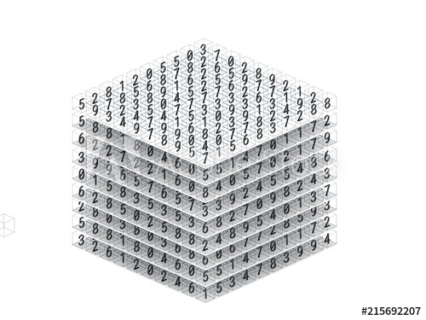
3-Dimensional tensor
This can be thought of as an array of arrays of arrays
Can be visualized as a cube with every cell of the cube having a value
Can be constructed by:
tf.tensor3d([[[1, 2], [3, 4]], [[5, 6], [7, 8]]]) - pass in a nested array of arrays that are the same size
tf.tensor([1, 2, 3, 4, 5, 6, 7, 8], [2, 2, 2]) - pass all the values in a single array as first parameter, then the dimensions ([x, y, z]) and shape (2, 2, 2)
Notes:
Here it becomes useful to look at the API’s

Slide 25
N-Dimensional tensor
We aren't used to higher dimensions because we live in three, with the fourth being objective
Some visualize the higher dimensions as an array of cubes (4D) or grid of cubes (5D)
To create there are still tensor4d, tensor5d, and tensor6d, but tf.tensor will be used for anything higher than that
Notes:
Here it becomes useful to look at the API’s

Slide 26
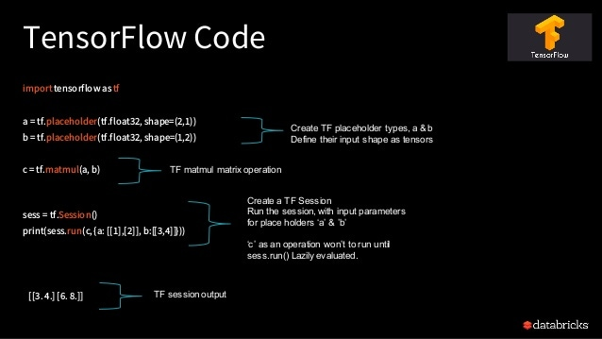
TIME TO LOOK AT CODE!!

Slide 27


Slide 28


